Slide 1
RFID Scanner for Blockchain
Assignment member:
Shashwat Khare
2017A8PS0249P

Slide 2
Hardware used

Slide 3
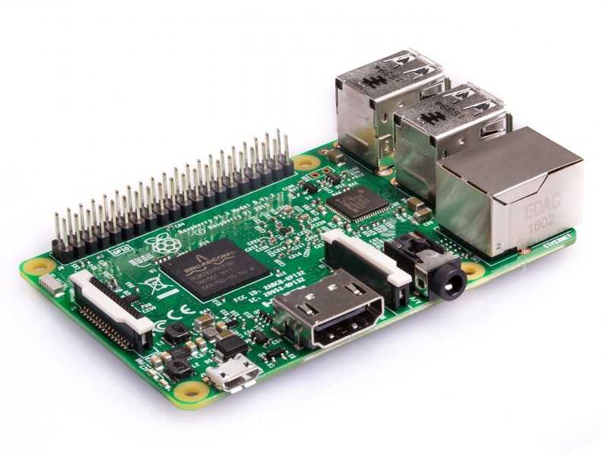
Raspberry Pi 3 Model B

Slide 4
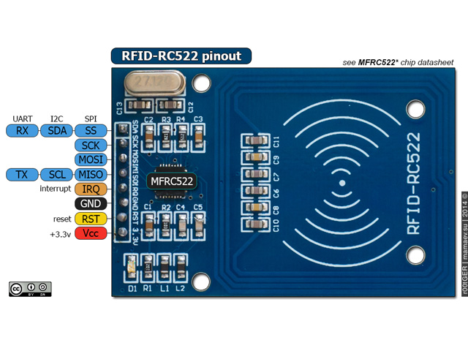
MFRC522 RFID Card Reader

Slide 5
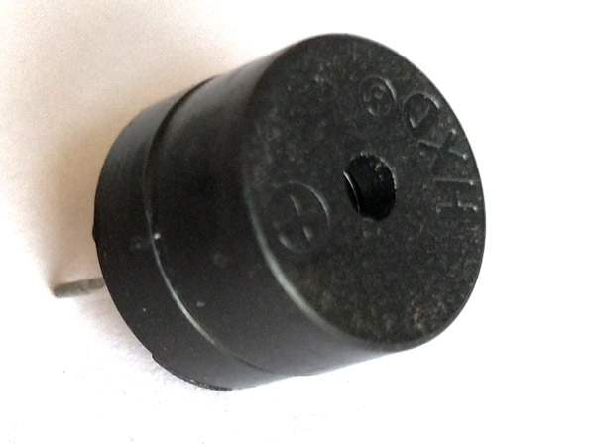
Active buzzer

Slide 6
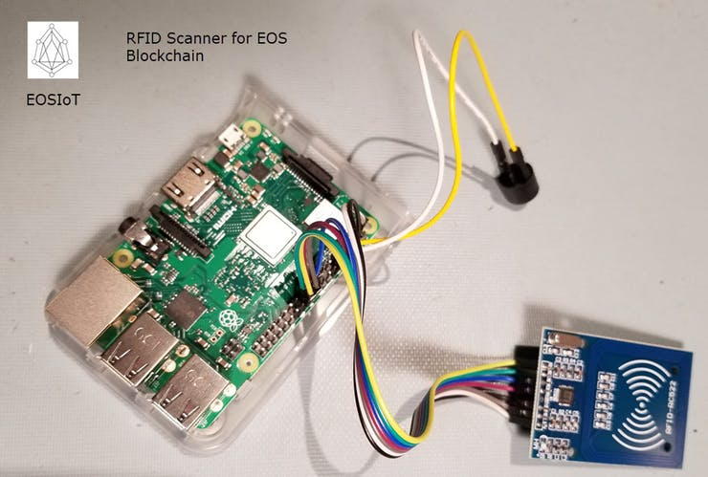
Hardware setup

Slide 7
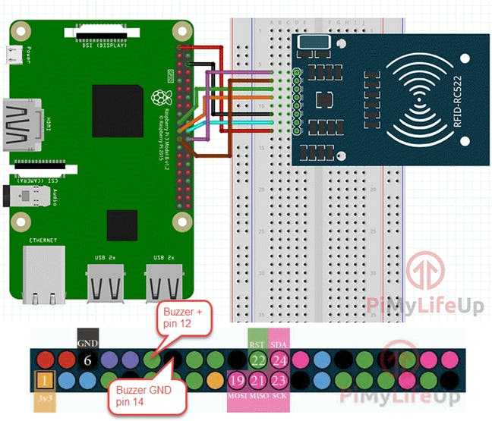
Wiring

Slide 8
Software Setup
Latest Raspbian OS
Recent Node.js. The version (8.11.1) that comes with Raspbian works.
NPM package manager. Install it then update it:
sudo apt-get install npm
sudo npm i -g npm
Git (already installed)
Clone the repository onto your Pi as follows and go to the location of the cloned folder:
$ git clone https://github.com/EOSIoT/rfid-scanner-node.git
$ cd rfid-scanner-node
Install project dependencies:
$ npm install

Slide 9
Using the IoT device
Run the application with super-user privileges.
Take note of the unique device ID to reference the scanner's data in the demo web application.
If the application was setup correctly, you will see the results of an initial blockchain info request, showing that communication with the designated EOS API endpoint is working

Slide 10
Using the IoT device (cont.)
To scan a card or tag, place it near (within 2 cm) the mfrc522 reader's top (antenna) side.
You'll hear a beep sound from the buzzer confirming the scan.
The tag's UID and the current time on the Raspberry Pi IoT device is then bundled up into a transaction and sent to the EOS blockchain where it is quickly absorbed into a block.
The RFID scanner software has a private key enabling it to submit tag data on behalf of the eosiot11node account. The tag's UID data is placed into a database hosted by a smart contract under the eosiot11rfid account.

Slide 11
A note
A blockchain smart contract eosiot11rfid and a device account eosiot11node is already setup and waiting to receive the RFID scanner data, so nothing has to be done on the blockchain side to see the scanner data appear on the chain. The account being "billed" for transaction bandwidth and the account hosting the smart contract are both located on the mainnet chain - the EOS flagship blockchain (real-time status).
The blockchain account created for this project (eosiot11node) is shared between every IoT device that uses the software. There is a limited amount of bandwidth and CPU allocated to it, and with enough users the daily limits will be reached. However, we can setup our own device account(s) where we can control access and allocate resources, and even deploy our own dApp (to see the scanned tag data appear on the EOS blockchain in near real-time).

Slide 12
References
Project page: https://www.hackster.io/firmwareguru/build-an-rfid-scanner-for-blockchain-1fbdb3
Software code: https://github.com/EOSIoT/rfid-scanner-node
Demo web application: https://github.com/EOSIoT/rfid-html

